Slide 1
CS5551 Advanced Software Engineering Software Architecture and Patterns: Android

Slide 2
What is Software Architecture?
High level structures of a software system
a collection of computational components
connectors describing the interaction between these components
constrain on how they can be combined
Architecture Characteristics
Conceptual integrity: the role of "keeper of the vision”
Multitude of stakeholders, e.g., business managers, owners, users and operators
Separation of concerns: to reduce complexity is to separate the concerns that drive the design.
Quality-driven: Fault-tolerance, compatibility, extensibility,
reliability, maintainability, availability.
Recurring styles: Architectural style, Tactic, and Architectural Pattern.
Notes:
Multitude of stakeholders: software systems have to cater to a variety of stakeholders such as business managers, owners, users and operators. These stakeholders all have their own concerns with respect to the system. Balancing these concerns and demonstrating how they are addressed is part of designing the system.^{[3]:pp.29–31} This implies that architecture involves dealing with a broad variety of concerns and stakeholders, and has a multidisciplinary nature.
Separation of concerns: the established way for architects to reduce complexity is to separate the concerns that drive the design. Architecture documentation shows that all stakeholder concerns are addressed by modeling and describing the architecture from separate points of view associated with the various stakeholder concerns.^{[11]} These separate descriptions are called architectural views (see for example the 4+1 Architectural View Model).
Quality-driven: classic software design approaches (e.g. Jackson Structured Programming) were driven by required functionality and the flow of data through the system, but the current insight^{[3]:pp.26–28} is that the architecture of a software system is more closely related to its quality attributes such as fault-tolerance, backward compatibility, extensibility, reliability, maintainability, availability, security, usability, and other such –ilities. Stakeholder concerns often translate into requirements on these quality attributes, which are variously called non-functional requirements, extra-functional requirements, behavioral requirements, or quality attribute requirements.
Recurring styles: like building architecture, the software architecture discipline has developed standard ways to address recurring concerns. These "standard ways" are called by various names at various levels of abstraction. Common terms for recurring solutions are architectural style,^{[10]:pp.273–277} tactic,^{[3]:pp.70–72} reference architecture^{[12][13]} and architectural pattern.^{[3]:pp.203–205}
Conceptual integrity: a term introduced by Fred Brooks in The Mythical Man-Month to denote the idea that the architecture of a software system represents an overall vision of what it should do and how it should do it. This vision should be separated from its implementation. The architect assumes the role of "keeper of the vision", making sure that additions to the system are in line with the architecture, hence preserving conceptual integrity.^{[14]:pp.41–50}

Slide 3
Software Architecture Styles
Architectural styles are abstractions for classes of organizational patterns encountered in software engineering practice
Characterization
vocabulary
configuration rules
semantics
Benefits
design reuse
predictability
corporate knowledge
Taxonomic principle
The dominant strategy for separating of concerns
composition
communication
coordination
Ref: Gruia-Catalin Roman and Christopher Gill, Robust Design Strategies

Slide 4
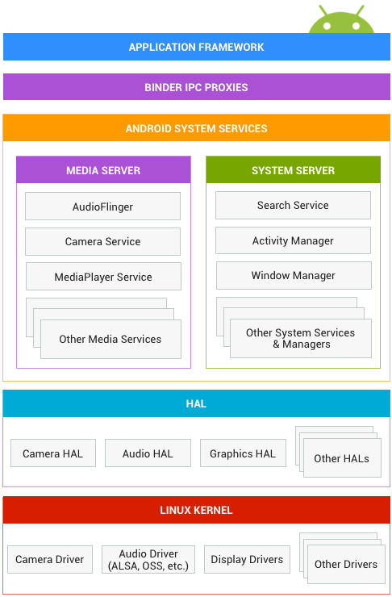
Android Architecture
The application framework is used most often by application developers.
The Binder Inter-Process Communication (IPC) enables high level framework APIs to interact with Android system services.
System services: exposed by application framework APIs communicates with system services to access the underlying hardware
Hardware abstraction layer (HAL) defines a standard interface for hardware vendors to allow us to implement functionality without affecting or modifying the higher level system.
https://source.android.com/devices/

Slide 5
Android's Application Framework: Components
Rich and innovative apps using a set of reusable components.
Components define the building blocks of your app
Connect them together using intents.
http://developer.android.com/guide/components/index.html

Slide 6
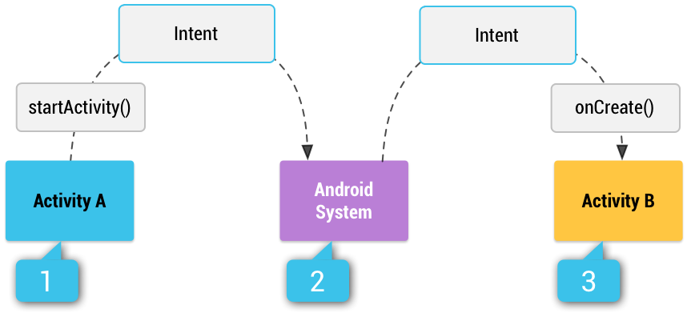
Intent (“connector”)
a messaging object to be used to request an action from another app component.
e.g., to start an activity, start a service, deliver a broadcast:
http://developer.android.com/guide/components/intents-filters.html

Slide 7
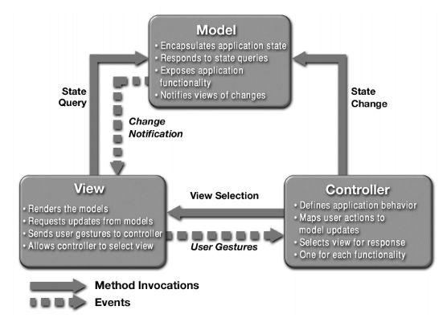
Design Patterns: Model View Controller (MVC)
Models: Content Providers. Data Managers are the recommended form of inter-application data sharing.
Views: Activities. This is the application's primary user interface component. Every individual screen of an Android application is derived from the Activity Java class (android.app.Activity). They are containers for Views (android.view.View).
Controllers: Services. These are background components defining application behaviors that behave like UNIX daemons and Windows services. They run invisibly and perform ongoing unattended processing.
http://www.bogotobogo.com/DesignPatterns/mvc_model_view_controller_pattern.php

Slide 8
Content Providers (Models)
The standard interface
connects data in one process with code running in another process.
manages access to a structured set of data.
encapsulates the data, and provides mechanisms for defining data security.
http://developer.android.com/guide/topics/providers/content-providers.html

Slide 9
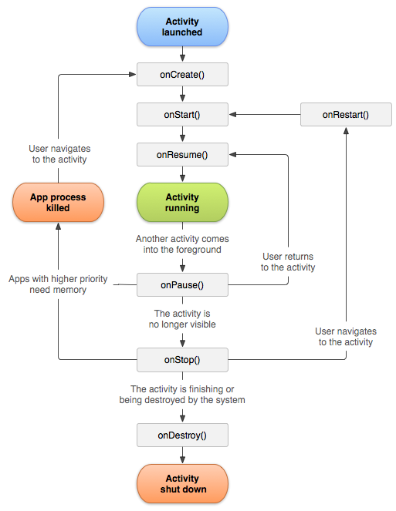
Activities (Views)
The activity lifecycle
An application usually consists of multiple activities that are loosely bound to each other.
An application component that provides a screen to users for activities
e.g., dial the phone, take a photo, send an email, or view a map
http://developer.android.com/guide/components/activities.html

Slide 10
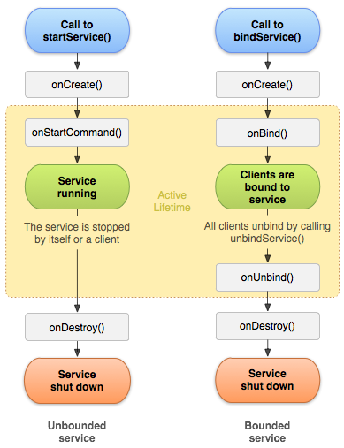
Services (Controllers)
An application component that can perform long-running operations in the background and does not provide a user interface.
Figure. The service lifecycle.
The diagram on the left shows the lifecycle when the service is created with startService() and the diagram on the right shows the lifecycle when the service is created with bindService().

